Slide 1
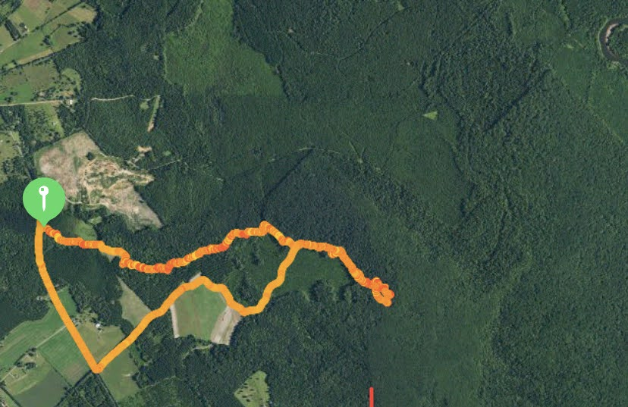
Apple Maps/Tom Tom (Unknown Date)
Landing Zone
Start point
End point

Slide 2
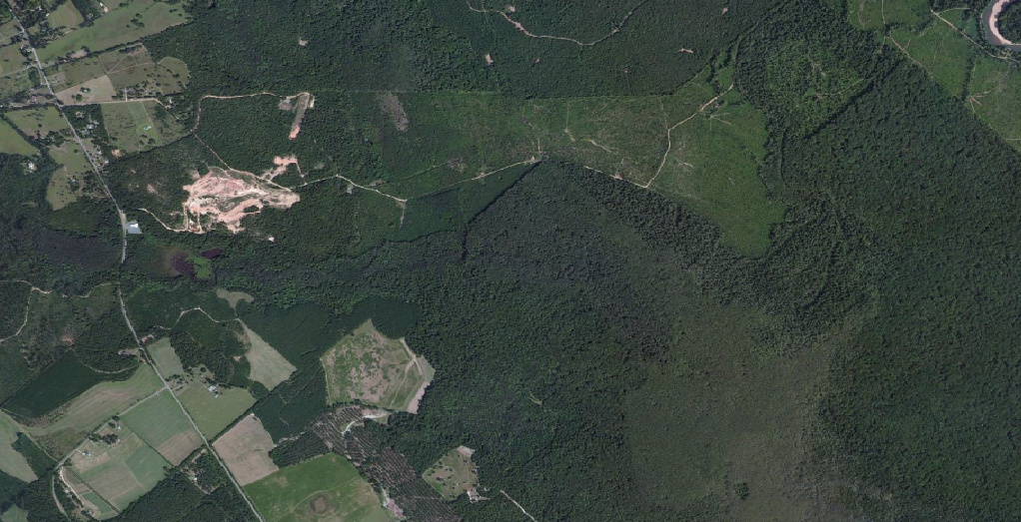
Bing Maps/Tom Tom (Unknown Date)
Landing Zone
Start point
End point

Slide 3
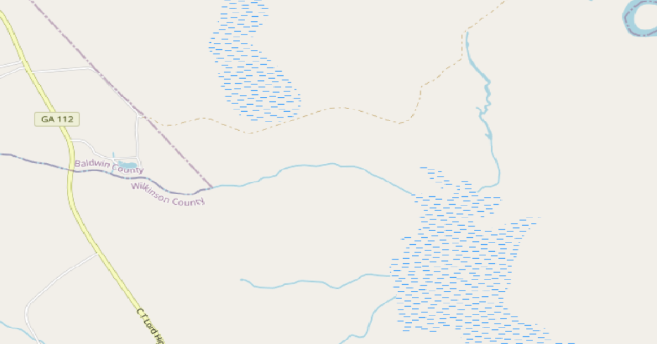
Open Street Map
Landing Zone
Start point
End point

Slide 4
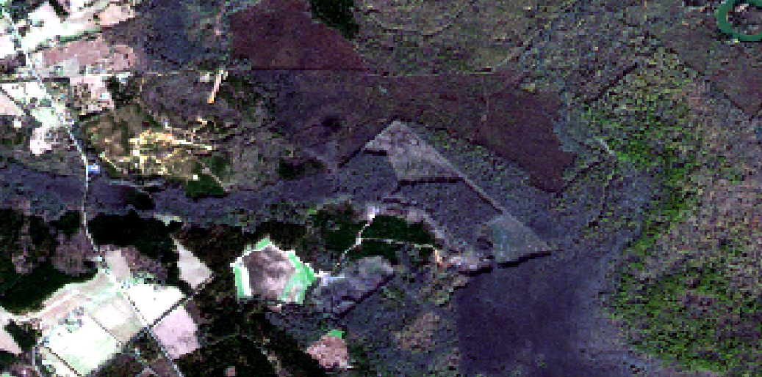
True Color
Sentinal 2 L1C (12-27-2020)
Landing Zone
Start point
End point

Slide 5
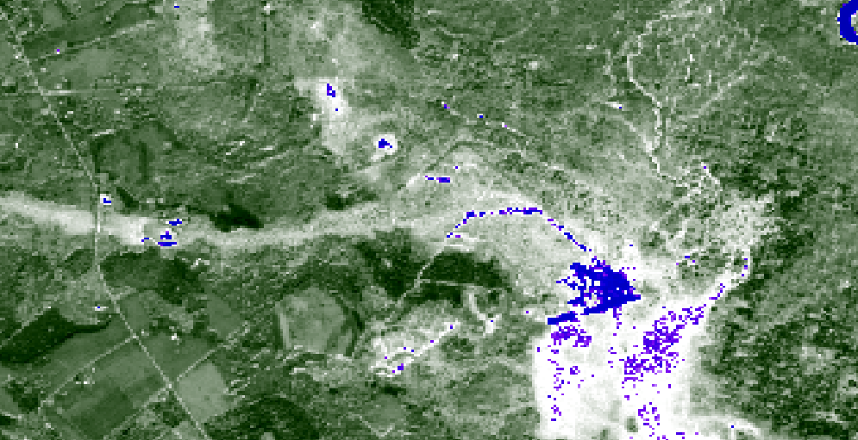
Water Index
Blue is water
Green is vegetation
Sentinal 2 L1C (12-27-2020)
Landing Zone
Start point
End point

Slide 6
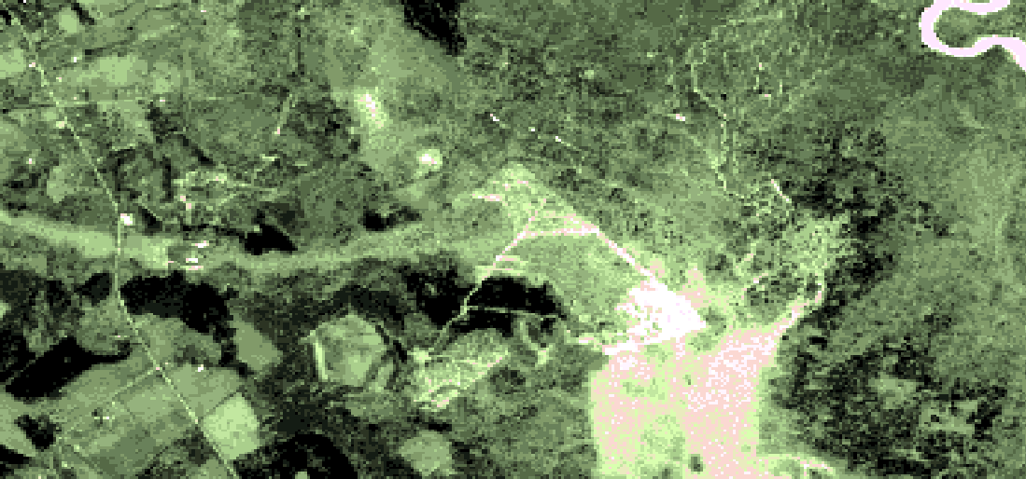
Vegetation Index
Lighter is less dense
Darker is more dense
Sentinal 2 L1C (12-27-2020)
Landing Zone
Start point
End point

Slide 7
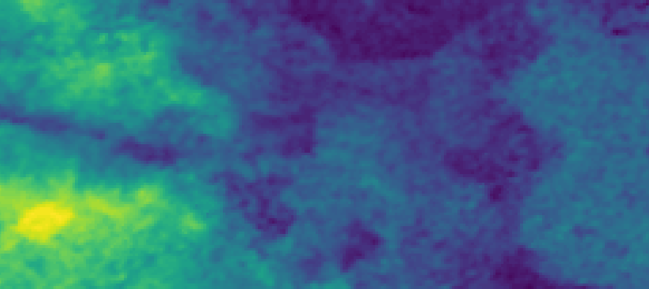
Elevation
Lighter is higher
Darker is lower
SRTM Elevation (02-2000)
Landing Zone
Start point
End point

Slide 8
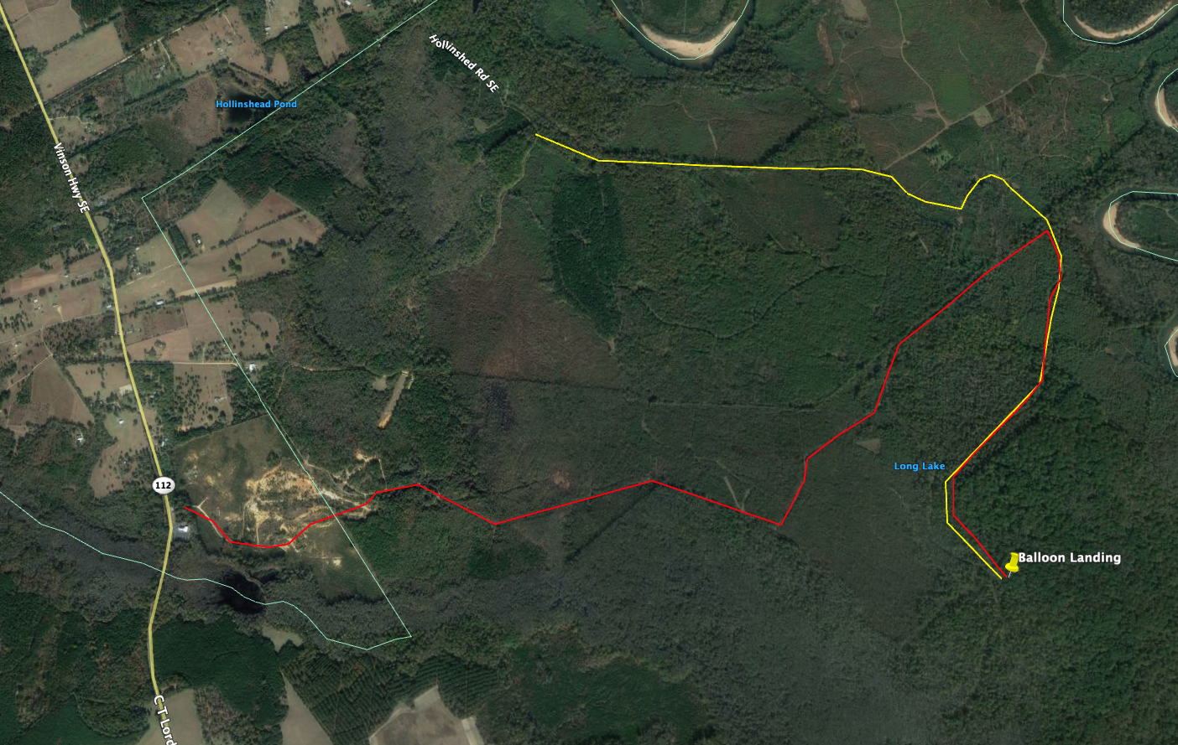
Recovery Attempt #2 Options
Google Earth (11/2019)
3mi
4.38mi
Possible End of Dirt Path (Bing maps)

Slide 9
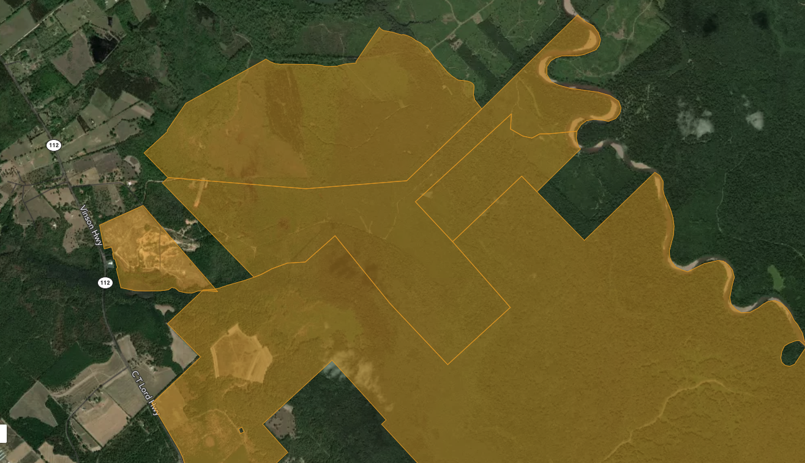
Parcel Map
Acrevalue.com
Betty R. Purcell
Old Capital
Gun Club
Jim Purcell
Landing Zone
Baldwin
County
Black Lake Managing Corporation/
Black Lake Plantation

